Slide 1
DSP Addressing
How direct, indirect, and circular modes speed memory access
Done by,
Dhinakaran S

Slide 2
Addressing Modes
Direct addressing embeds the full address or offset in the instruction (example: load R1, [0x2000]), ideal for constants or fixed lookup tables. Indirect addressing uses a register as a pointer, optionally with auto-increment/decrement (Memory is accessed via a address register pointer (e.g., LOAD R0, (AR0).useful for traversing arrays without changing explicit operands. Circular addressing uses hardware-managed wrap(Memory wraps around automatically when reaching a set boundary ().

Slide 3
Reduce Access Overhead
Memory-access overheads shrink with addressing modes in tight DSP loops. A 64-tap FIR using explicit index arithmetic needs index update plus modulus per tap, adding two instructions per tap and boosting cycles by ~30–50% versus pointer-based access. Copying audio samples with indirect auto-increment avoids repeating load-immediate or add per sample, saving 1–2 cycles on many DSPs. Across millions

Slide 4
Indirect Addressing Pattern
01
02
03
04
Base Load
Auto-Increment Load
Loop Counter
Stride Handling
Load the base address into Rptr to point at sample[0].
Fetch each sample with auto-increment, e.g., LOAD Racc, [Rptr++].
Keep a separate loop counter and branch on it to bound the loop.
For strided access, add a fixed stride to Rptr every N iterations or use a scaled index.

Slide 5
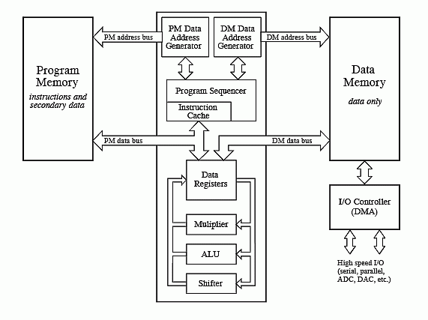
Addressing Gains
2048
cycles saved over a 1024-sample block (2 cycles per access) with auto-increment load
0.023
cycles per sample saved via circular mode (3-cycle modulus every 128 samples)
Indirect and circular addressing cut cycles and code size, boosting DSP kernel throughput.
30%
average code-size reduction from removing explicit index maintenance (20–40% range)

Slide 6
Circular Addressing
Allocate Buffer
Config CB
Init Pointers
Circular Access
Validate Metrics
Choose a power-of-two or configured-size buffer and align it in memory.
Program the processor’s circular-buffer base and length (or a mask for power-of-two).
Initialize read and write pointer registers.
Use loads/stores that reference the circular pointer; hardware increments and wraps automatically.
Measure cycles per sample in a tight loop; verify zero branch mispredictions at wrap and compare code size pre/post.

Slide 7
Access Mode Wins
Direct addressing minimizes decoding and provides predictable access for fixed data locations. Indirect addressing enables pointer-driven access that lowers instruction counts for indexed streams. Circular addressing removes explicit modulus work, delivering low-overhead wraparound for ring buffers and higher throughput. Choosing the right mode for static lookups, indexed streams, or streaming.

Slide 8
Thank You

